Slide 1





GradNav
Navigating Futures, Transforming Lives
Stephanie Ulogwara &
Chukwuemeka Martins Ejike

Slide 2






What is GradNav?
We inform 2nd-level students on career paths and further education opportunities based on 6 factors.
Senior Cycle Subjects
Skills
Background
Character Traits
Hobbies
Experiences.

Slide 3



Belief: Every person is able for university and should have the opportunity.
Problem: People often pursue unsuitable careers, leading to wasted time, money and opportunity.
Approach: Provide targeted course and career recommendations.
Objective: Prevent career misalignment and unnecessary educational expenses.
Our Motivation

Slide 4



The Market
(Over 300,000)
Guidance Counsellors
Students and Parents
Institutions
Offering tailored career and education recommendations for students aiding the job of counsellors
Over 730 secondary schools, 203,043 Senior Cycle Students and approx. 100,000 parents/guardians
Dept of Education, secondary schools and educational bodies like Higher Options, CAO.ie, Qualifax

Slide 5

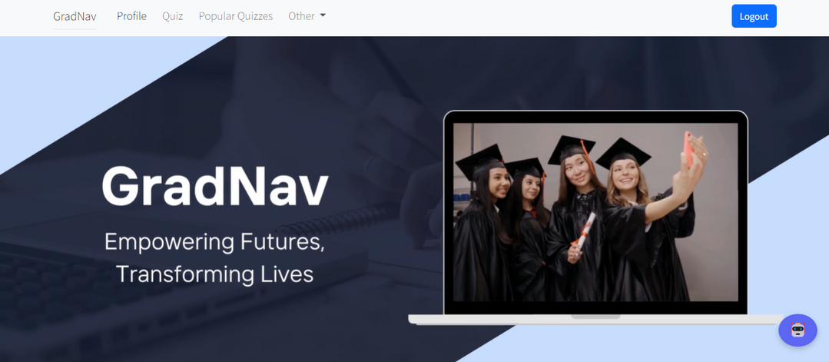
The Competition
Us vs The Competition
Consider subjects
Consider likes (hobbies)
Do not consider reasoning/backgrounds
Often do not consider disabilities
Often do not consider values
GradNav surpasses competitors by offering personalized guidance that includes dislikes, accessibility features, and salary insights, ensuring a better match for students' career paths.
GradNav
We consider subjects (and disliked subjects)
We consider reasoning/backgrounds
We consider disabilities
We offer salary insights
We widen perspectives

Slide 6

Primary Research
We consulted with parents and students to tailor our career exploration app. Parents supported the app, believing it will aid their children in making informed career choices.
Students desired a broad career selection, brief quizzes, and user-friendly design. Their feedback shaped both the development and the marketing of our app to appeal to both groups.

Slide 7

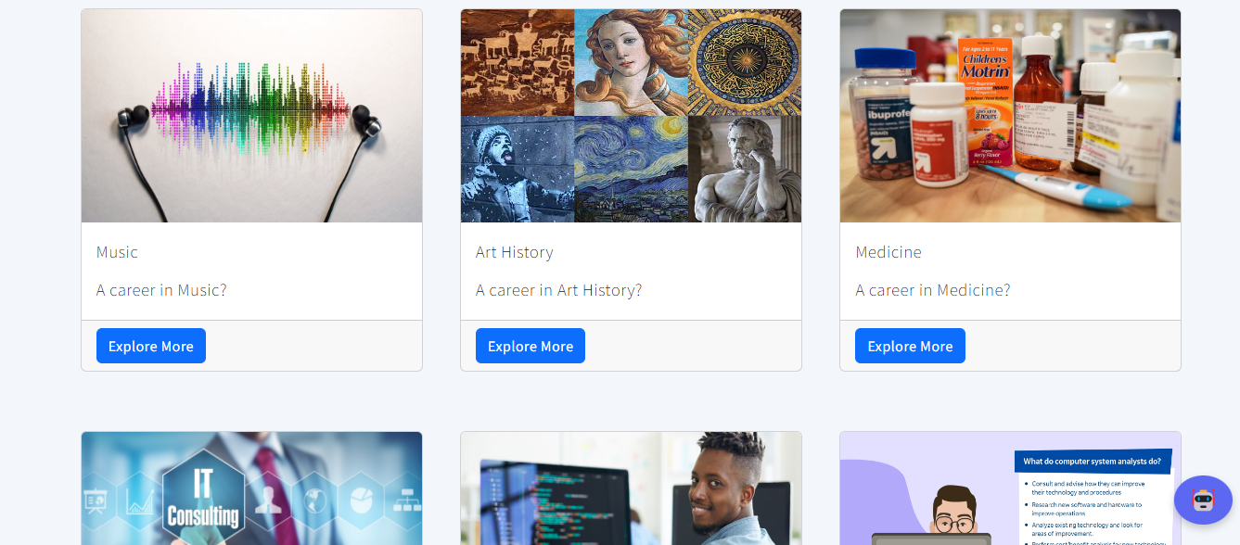
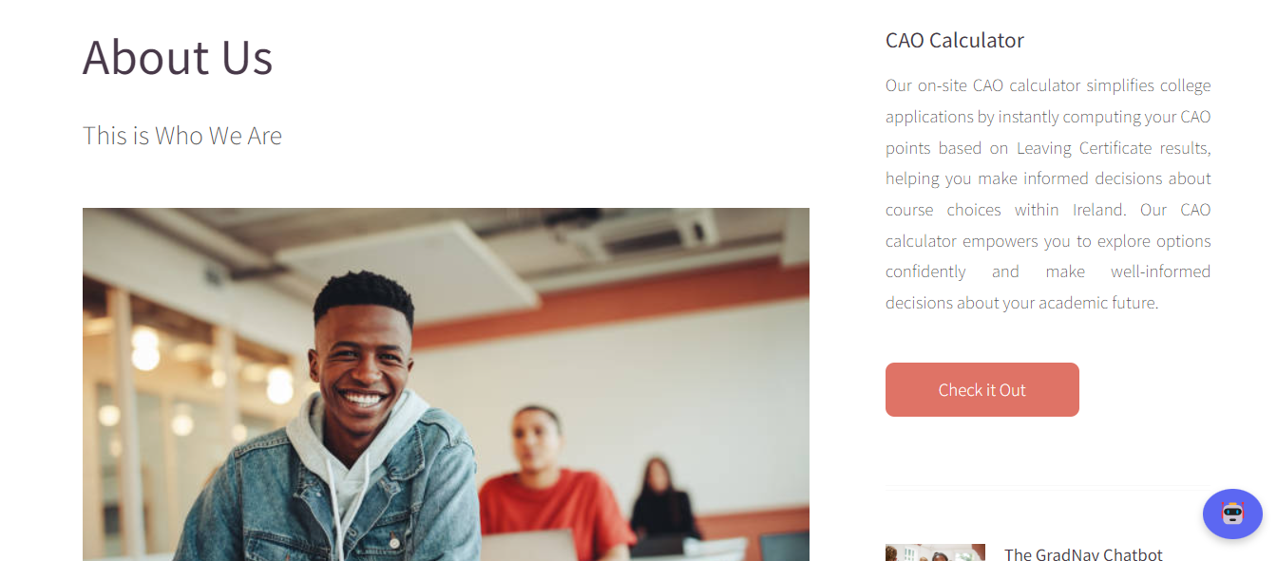
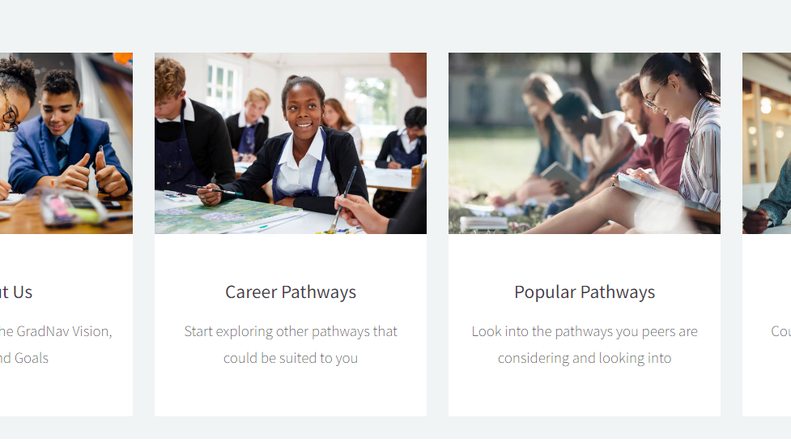
Features

Slide 8





Application
Web Design & Programming
CSS, JavaScript & Bootstrap for friendly UI. Django for backend development
Project Management
Applied project management skills to oversee & manage development.
Innovation & Entrepreneurship
Leveraged OpenAI sources and innovative strategies to create competitive app features.

Slide 9

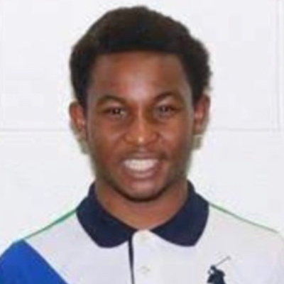

Contributions
Stephanie
Martins
Designed Webpage, Popular Courses Recommendation Logic, CAO Calculator Logic, HTML, CSS and JavaScript
Created Chatbot, Course Recommendation Logic, Multi Registration Process, Additional Course Info based on Quiz Result Logic

Slide 10

Challenges
Challenges
Co-ordinating the webpage, designing all pages containing logic, managing multiple CSS/JavaScript files, working across sub-apps.
Creating the Chatbot and course recommendation logic. Aligning registration process with additional course info based on quiz result logic.

Slide 11
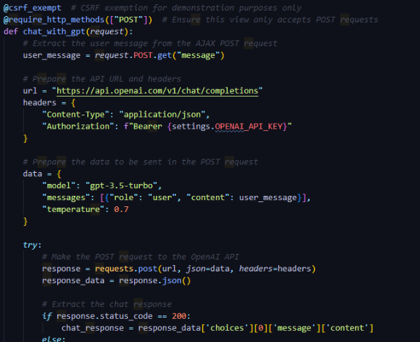
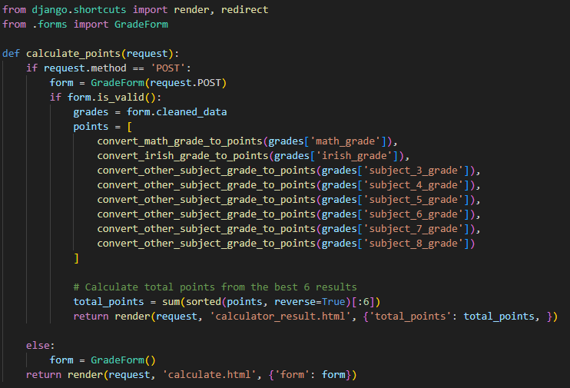
Code Snippets
ChatBot
CAO Calculator

Slide 12


Thomas
McKiernan
17 Years Old
6th Year Student at St Aidan’s CBS
Irish
Creative, Resilient, Independent
Let’s Test it Out!
More Context
Skills: Problem-solving, Time Management, Writing
Hobbies: Gaming, Football, Reading
Values: Role Variation, Career Flexibility (Hybrid/Remote), High Salary
Background: Low Income Family
Senior Cycle Chosen Subjects: Science, Engineering, Applied Maths, Spanish, English, Irish, Spanish

